Slide 1
Weather Or Not To Go
Nick O., Nick I., Chaula, Deb (in absentia)
(Click Here to SEE A BRIEF Intro From Deb)

Slide 2
User’s Challenge/Our Inspiration
While planning for any event user needs to go to two different website to plan for the event.
Create a site for event-goers where they can find events for the day and the weather with one click of a finger.
Verified that if Weather and Event API are available or not.

Slide 3
Our MVP Solution
Input ZIP code.
Based on ZIP, pull relevant info from the OpenWeatherMap API and the EventBrite API.
Display the weather for next few hours and the events for the day on one the same page.

Slide 4
Technologies and languages used
HTML (Hypertext Markup language)
CSS (Cascading Style Sheets)
Javascript
jquery
Json (JavaScript Object Notation)
AjAx (Asynchronous Javascript and XML)
Moment.js
Weather API and Eventbrite api

Slide 5

TA DA!
https://coil-recoil.github.io/04-Star_Wars_RPG/

Slide 6
Hiccups
GitHub and its confusing branch pushing and pulling
Collectively deciding on a direction and moving forward
The OpenWeatherMap API will not work with a “www.”
How to display the returned information.

Slide 7
Interesting Tidbits
“time.calendar” returns day and time from the Unix time stamp.
The Kelvin conversion is:
var displayTemp = parseInt((pullTemp-273.15)*1.8)+32;
Based upon how the information was returned, we adjusted our design:
$("<tr><td>" + "<a href='" + eventLink + "'>" + event + "</a></td></tr>");

Slide 8
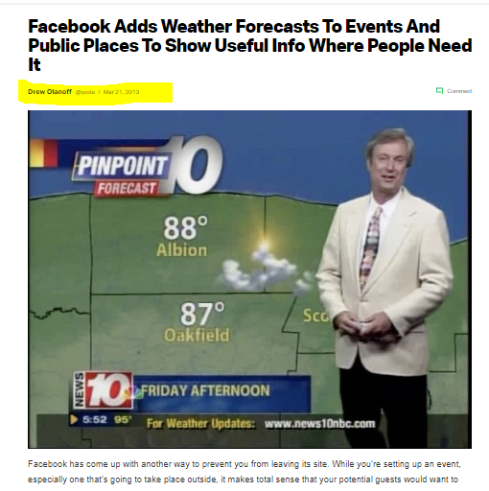
One step ahead!!!!!!!

Slide 9
Future development
Add weather.com link to weather icons.
Add “limit event results to 10” and make “show more results” button at bottom.
Add weather icons to indicate rain or sun
Possibility to see future events.

Slide 10

Conclusions and Lessons Learned
Group work is hard!
It’s really important to communicate effectively in order to work collaboratively (listen, share, structure and follow a plan).
Stick to the MVP!

Slide 11


Slide 12


